Slide 1






Hostel Management System

Slide 2



Instructor
Farhana Akter Lucky
IsDB-BISEW
Submitted To
Mohammad Moshaidul Islam
Consultant
IsDB-BISEW
Osman Goni
ID:1288825
Round:65

Slide 3
Index
INDEX OF PROJECT
Slide No.
Proposal Application
4
Introduction
5
Objectives
6
Benefits
7
Software Features
8
Entity Relationship Diagram
9
Software Flowchart
10
Modules
11
Timeline and Milestone
12
Technical Information Source
13
Use of Tools and Technologies
14
Roles
15
Methodology
17
Example of Invoice Reports
18
Forms Samples
20
Conclusion
22

Slide 4
Application
th, 2025 The Consultant
IDB Bhaban,
Sher e Bangla, Nagar, Dhaka
Subject : Project proposal letter for the Hostel Management System.
Dear sir,
Thank you for offering us a great opportunity to make a real life project based on our core course that is Web Development with PHP and Framework(WDPF). In this project, I would like to inform you that We have decided to make a project on Hostel management System, which is most important for every social media owner. I have studied about the various aspects of the system and make a proposal accordingly which is enclosed here with for your kind perusal. So, We think you will finally Approved the project and help to utilize our creativity.
Sincerely,
Name: Osman goni
Batch: WDPF/NCLC-M/65/01
Round - 65

Slide 5
Introduction
In our current era of automated systems with it being either software or hardware, it's not advisable to be using manual system. Hostels without a management system are usually done manually. Registration forms verification to other data saving processes are done manually and most at times, they are written on paper. Thus a lot of repetitions can be avoided with an automated system. The drawbacks of existing systems lead to the design of a computerized system that will help reduce a lot of manual inputs. With this system in place, we can improve the efficiency of the system, thus overcome the drawbacks of the existing manual system. This system is designed in favors of the hostel management which helps them to save the records of the students about their rooms and other things. It helps them from the manual work from which it is very difficult to find the record of the students and the mess bills of the students, and the information of about the those ones who had left the hostel years before.

Slide 6

Objectives
The core aim of the Hostel Management System is to streamline and digitize the everyday operations of hostel administration. This application focuses on efficiently managing information related to rent, allottees, hostels, rooms, beds, and payments. By eliminating the traditional manual system, it introduces a structured digital workflow that improves accuracy, saves time, and reduces paperwork.

Slide 7
Benefits
Automation of Tasks: Handles repetitive tasks like room allocation, fee collection, and attendance tracking.
Time Savings: Reduces manual workload for hostel staff, freeing them to focus on other priorities.
Error-Free Records: Ensures accurate data handling for room assignments, payments, and inventory management.
Room Allocation: Optimizes room usage by maintaining up-to-date records of occupancy.
Dashboard Insights: Provides an overview of hostel operations, including occupancy, financials, and issues.
Fee Collection: Automates billing, payment tracking, and late fee reminders.

Slide 8





Software Features
Different login system (student, admin)
Room and Bed Allocation
Resident Management
Room Assignment: Allocate rooms and beds based on availability and preferences.
Profile Management: Maintain detailed resident profiles, including personal information, guardian details, and medical records.
Vacancy Tracking: Monitor vacant, occupied, and reserved rooms in real-time.
Check-In/Check-Out Management: Record resident entry and exit efficiently.
Fee Management
Complaint and Feedback Management
Automated Billing: Generate invoices for rent, utilities, and other charges.
Complaint Resolution: Residents can log complaints directly in the system.
Payment Tracking: Record payments and monitor overdue amounts with reminders for defaulters.
Feedback Forms: Collect and analyze feedback to improve hostel services.

Slide 9
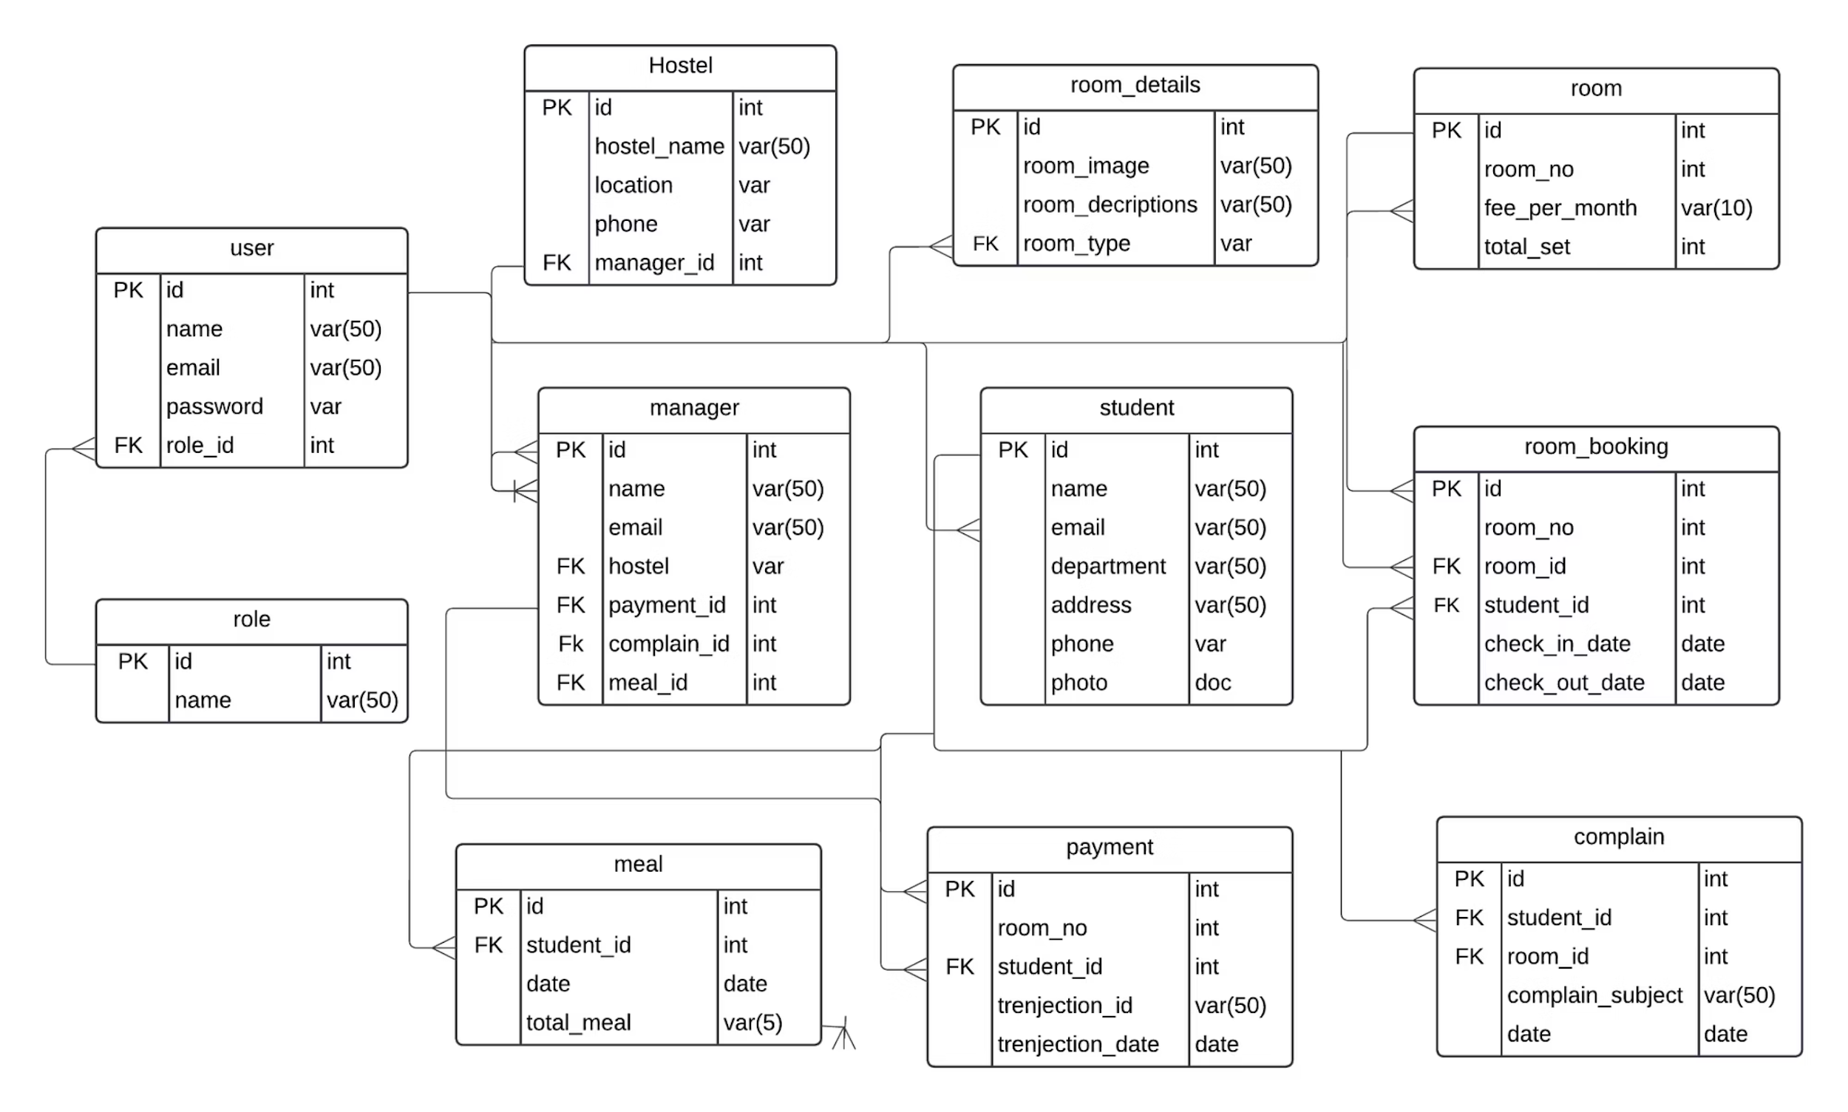
ERD – Entity Relationship Diagram

Slide 10
Timeline And Milestone:
Milestone
Duration (Days)
Requirements Gathering
2
Design and User Interface
5
Development and Coding
15
Testing and Quality Assurance
5
Deployment and Launch
2
Project Completion and Handover
1
Total Duration
30

Slide 11
Technical Information Source:
Information Source
Description
PHP.net
Official documentation and reference for PHP programming language
MySQL.com
Official documentation and resources for MySQL database management
system
W3Schools
Online tutorials and guides for web development technologies, including
PHP and MySQL
Stack Overflow
Online community for programmers to ask and answer technical questions
GitHub Repositories
Open-source projects and code repositories for PHP and MySQL

Slide 12
Use of Tools and Technologies:
Tools and Technology
Description
Tools and Technology
Description
PHP
Server-side scripting language used for dynamic web development
jQuery
JavaScript library for simplifying HTML document traversal and manipulation
MySQL
Relational database management system for storing and retrieving data
Git
Version control system for tracking and managing code changes
HTML
Markup language for creating the structure and content of web pages
PhpStorm
Integrated development environment (IDE) for PHP development
CSS
Styling language for enhancing the appearance and layout of web pages
phpMyAdmin
Web-based administration tool for managing MySQL databases
JavaScript
Client-side scripting language for interactive and dynamic web functionality
Tailwind
CSS framework for creating responsive and mobile-friendly web designs

Slide 13
Methodology
Collaboration and Communication:
Regular meetings will be scheduled among our team members to review
progress, discuss challenges, and make necessary adjustments.
We will actively seek feedback from stakeholders and incorporate it into the development process to ensure their needs are met.
We will utilize project management and collaboration tools, such as task tracking systems and communication platforms, to enhance transparency and efficiency.
Continuous Improvement:
Throughout the project, we will conduct regular retrospectives to identify areas of improvement and implement necessary adjustments.
Feedback from end users and stakeholders will be highly valued and utilized to enhance the software's functionality and user experience.

Slide 14
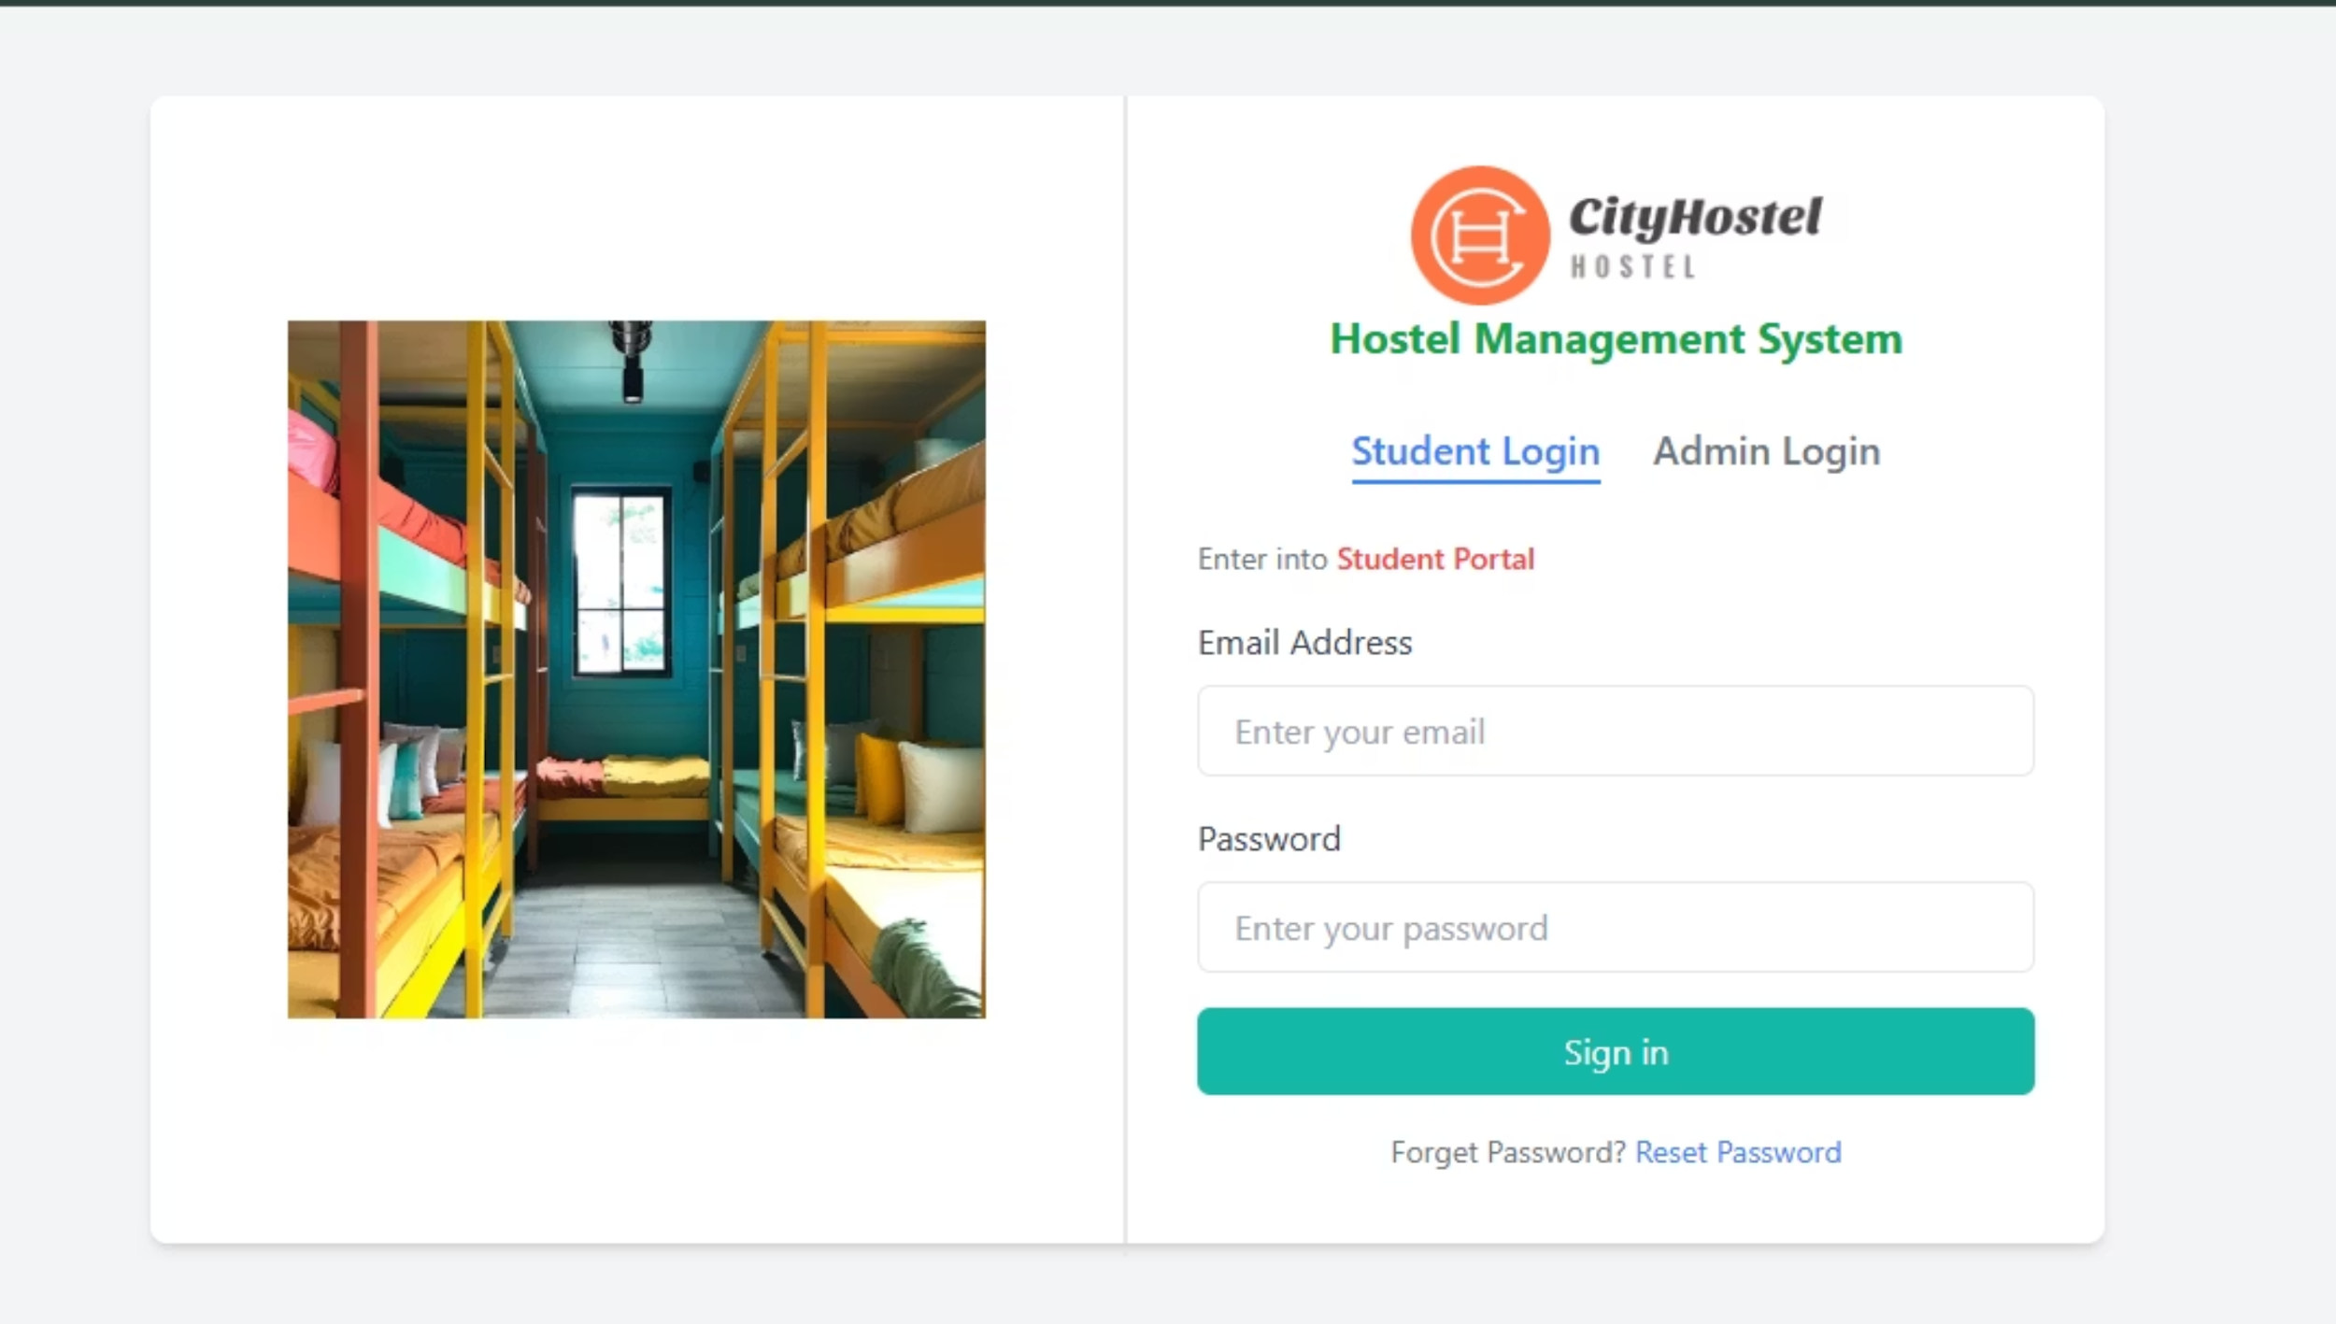
Login From

Slide 15
Conclusion
The Hostel Management System simplifies and streamlines the management of hostel activities, offering an efficient and reliable solution to common administrative challenges. Through its integration of advanced features such as room allocation, fee management, complaint tracking, and real-time reporting, the system reduces manual effort, minimizes errors, and enhances overall productivity.
By centralizing data and providing user-friendly interfaces, the system supports seamless communication among administrators, staff, and residents. This digital transformation not only saves time and resources but also ensures transparency and accountability in hostel operations.
As technology continues to evolve, this system can be further expanded with features like mobile accessibility, biometric integration, and AI-driven analytics, ensuring it remains a valuable asset for modern hostel management. Ultimately, the Hostel Management System contributes to a more organized, efficient, and user-friendly environment, fostering a positive experience for all stakeholders involved.

Slide 16



